Slide 1

Power Platform ALM
Michael Ochs, EVP, 7x MVP @Exalents
Power Platform Architect, ALM Expert by Practice

Slide 2
Agenda
Application Lifecycle Mgmt. Fundamentals
Power Platform ALM Landscape​
Pipelines for Power Platform​
Power Platform Build Tools and Automation​
ALM Accelerator for Power Platform

Slide 3
Application Lifecycle Fundamentals
Application Lifecycle Management of software includes plan and track, develop, build and test, deploy, operate, monitor, and learn from discovery.
For healthy ALM, there should be separate Dev, QA and Prod environments.
Source control should be your source of truth for storing and collaborating on your components.
Automated deployment mechanisms are preferred over manual.

Slide 4
Various Approaches to Choose from
Power Platform ALM Landscape
Manual deployment with export / import of solutions
Repeatable deployments with Pipelines for Power Platform
Automated deployment with Tools and Automation
Automated deployment with ALM Accelerator for Power Platform

Slide 5
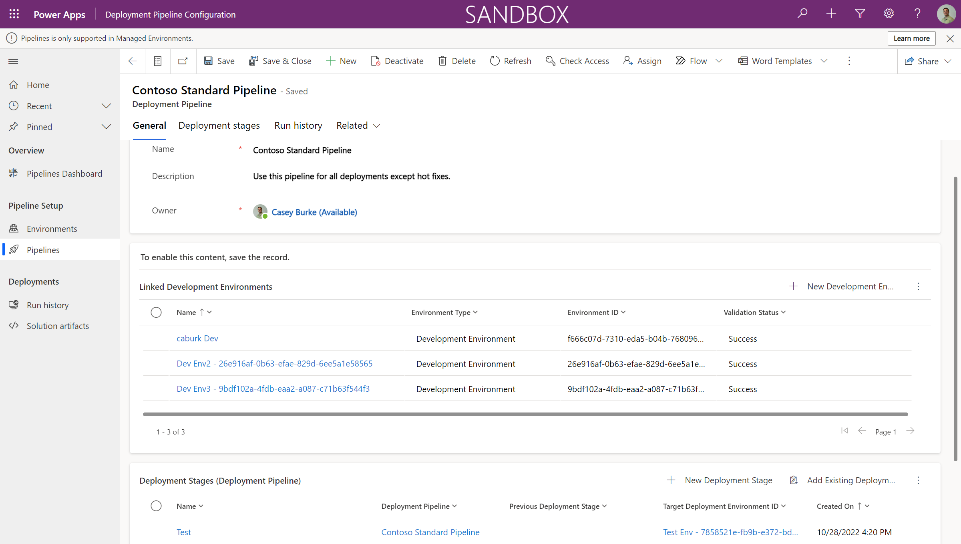
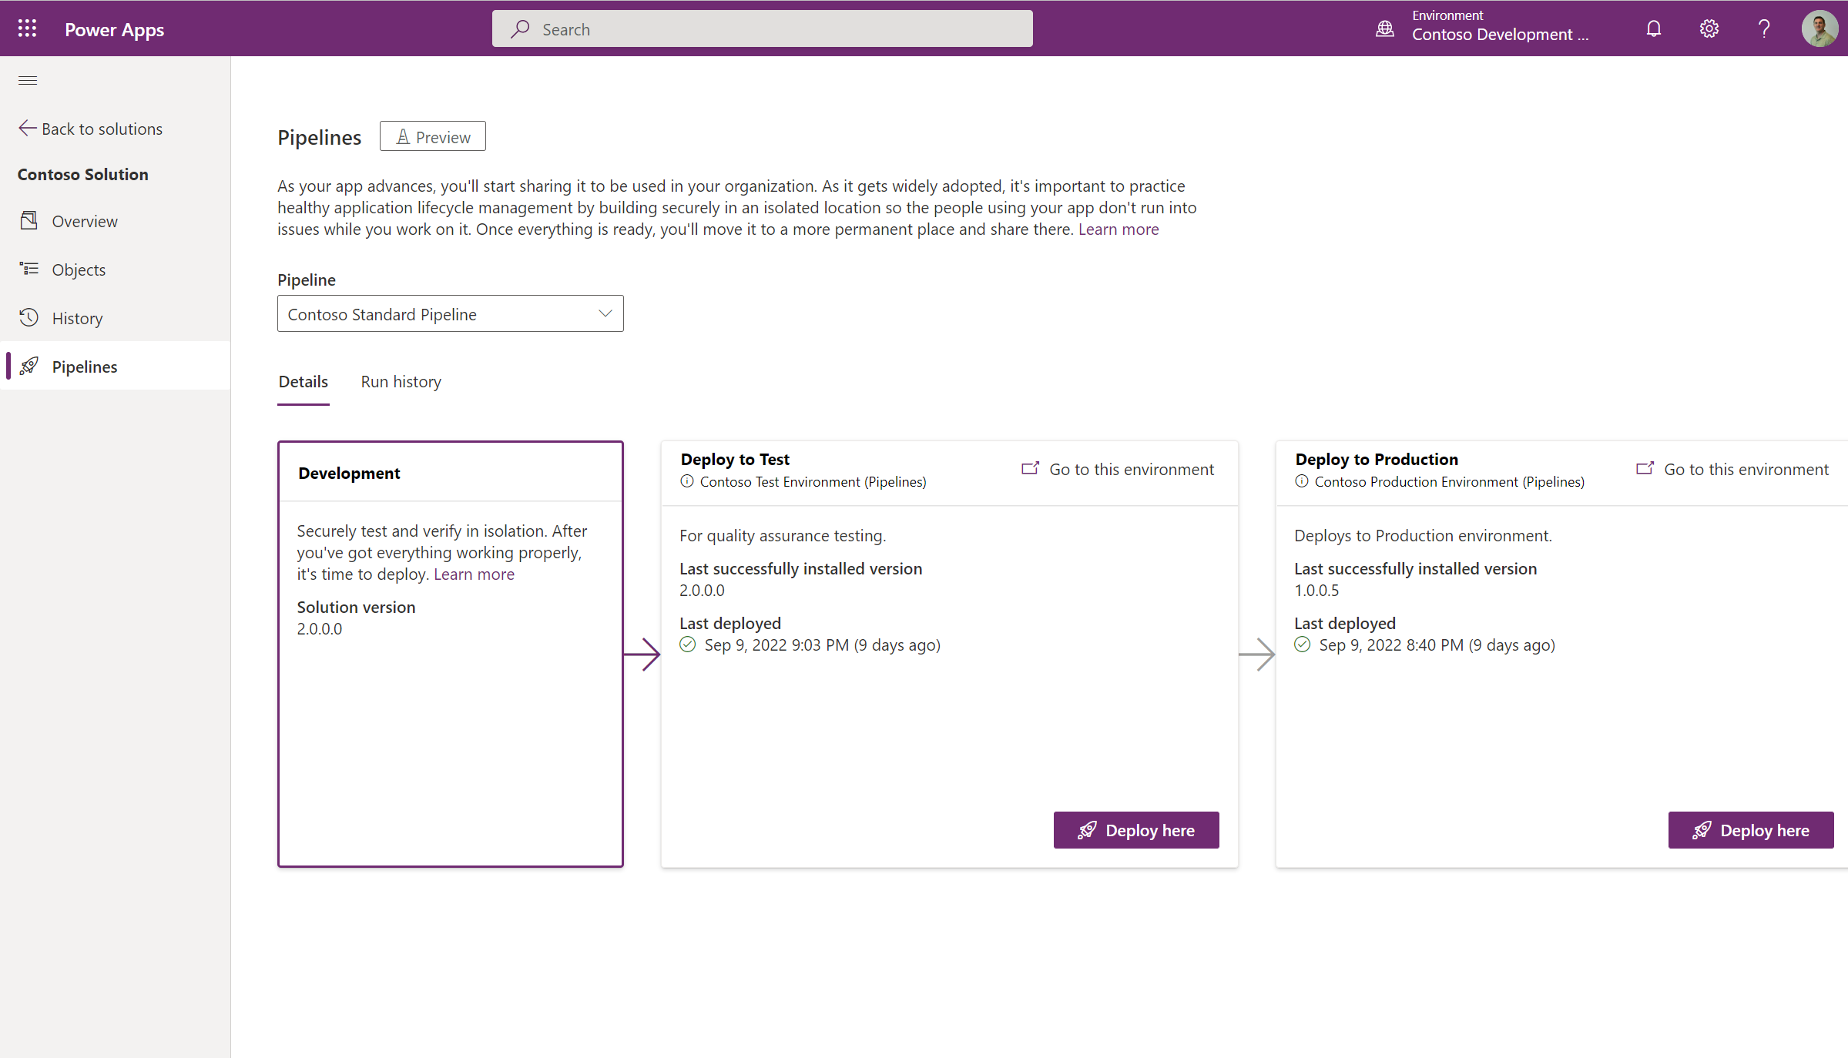
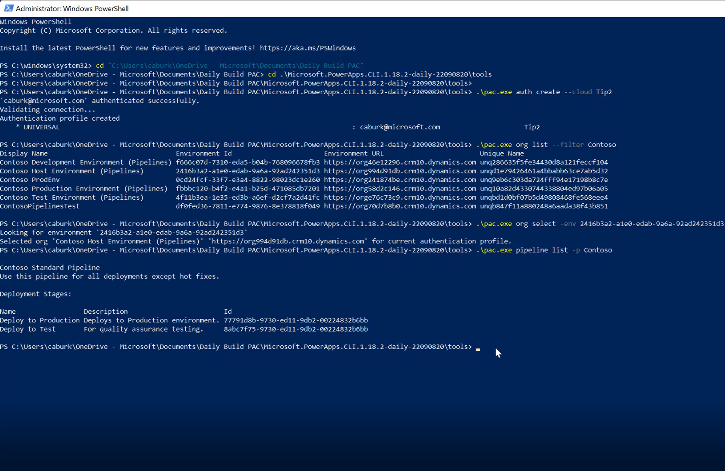
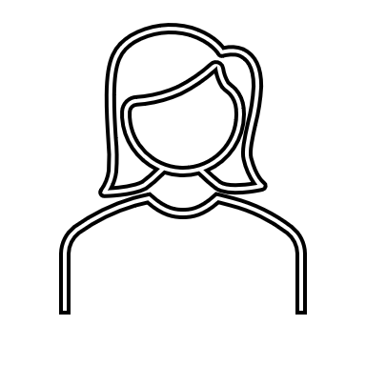
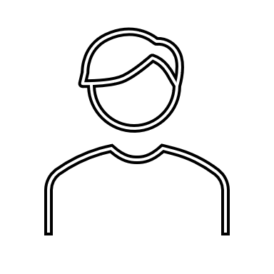
Pipelines simplify ALM for all makers
Setup Pipeline in < 2 min
Initiate automated deployments
Run pipelines via CLI
Admins
Citizen devs
Developers

Slide 6

Pipelines for Power Platform
Demo

Slide 7
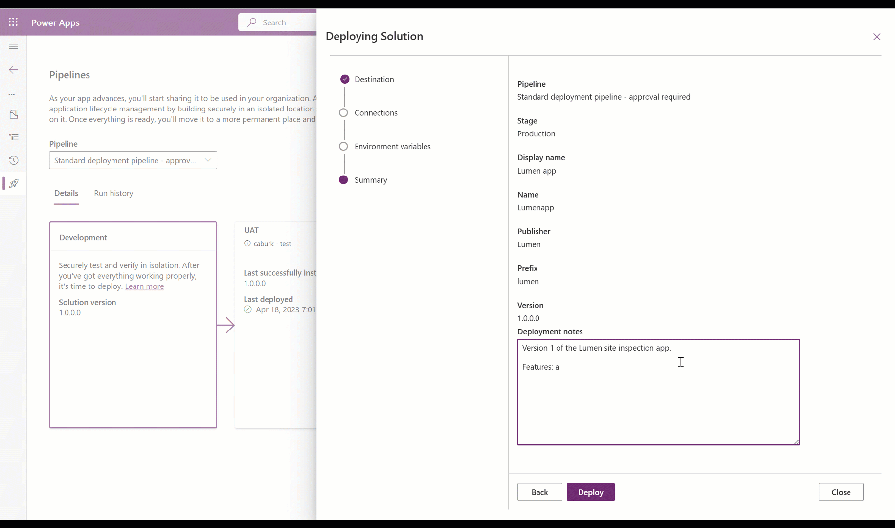
Additional Features
Schedule deployments
Release notes
Approvals
Extensibility
Cancel deployments
Available in all sovereign clouds
Cross-Geo deployments
Redeploy past solution versions

Slide 8
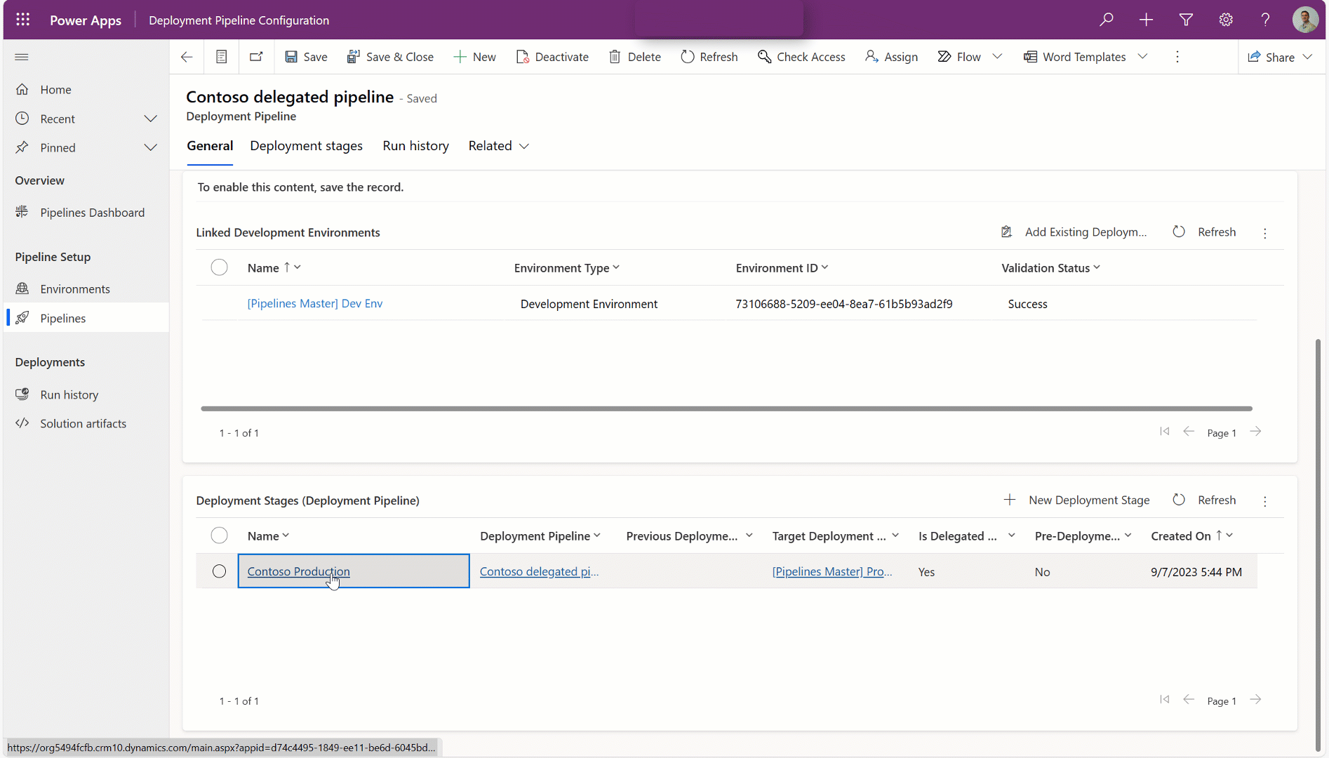
Pipelines delegated deployments (SPN)
And More…
Makers are empowered to deploy their applications to production without needing elevated permissions or support from admins.
AI generated deployment notes make it easy to approve or reject deployments.
Admins can rest assure their production data and application assets are protected and compliant with organizational least privileged access policies.

Slide 9

Pipelines delegated deployments (SPN)
And More…
Now in preview!
Power Platform Build Tools
Power Platform CLI
Makers are empowered to deploy their applications to production without needing elevated permissions or support from admins.
AI generated deployment notes make it easy to approve or reject deployments.
Admins can rest assure their production data and application assets are protected and compliant with organizational least privileged access policies.

Slide 10
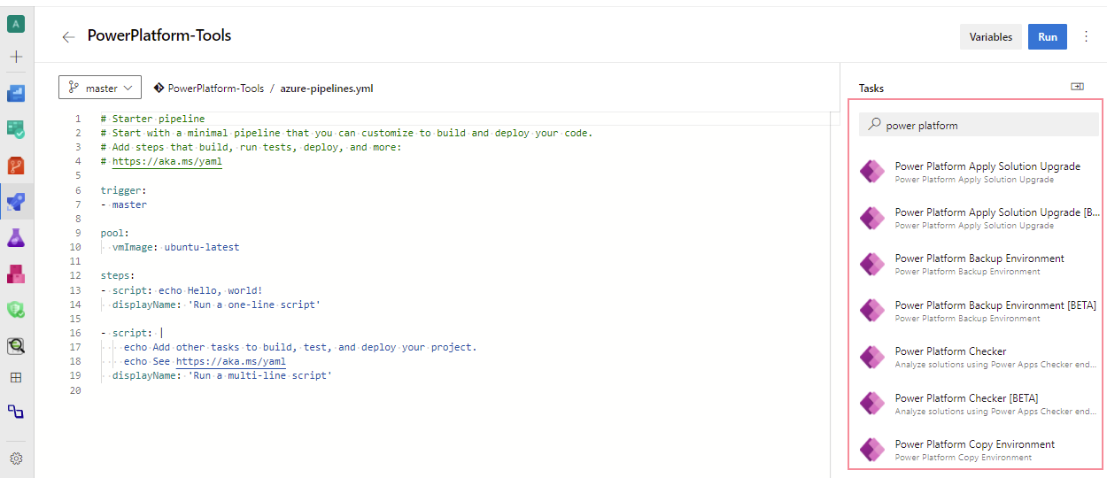
Power Platform Build Tools for Azure DevOps
Use Power Platform Build Tools to automate common build and deployment tasks related to Power Platform via Azure DevOps Pipelines.
This includes:
provisioning/de-provisioning of environments
synchronization of solution metadata (a.k.a. solutions) between development environments and source control
generating build artifacts
deploying to downstream environments
performing static analysis checks against your solution using the PowerApps checker service.

Slide 11


Power Platform Actions for GitHub
Use Power Platform Actions to automate common build and deployment tasks related to Power Platform via GitHub workflows.
This includes:
provisioning/de-provisioning of environments
synchronization of solution metadata (a.k.a. solutions) between development environments and source control
generating build artifacts
deploying to downstream environments
performing static analysis checks against your solution using the PowerApps checker service.

Slide 12
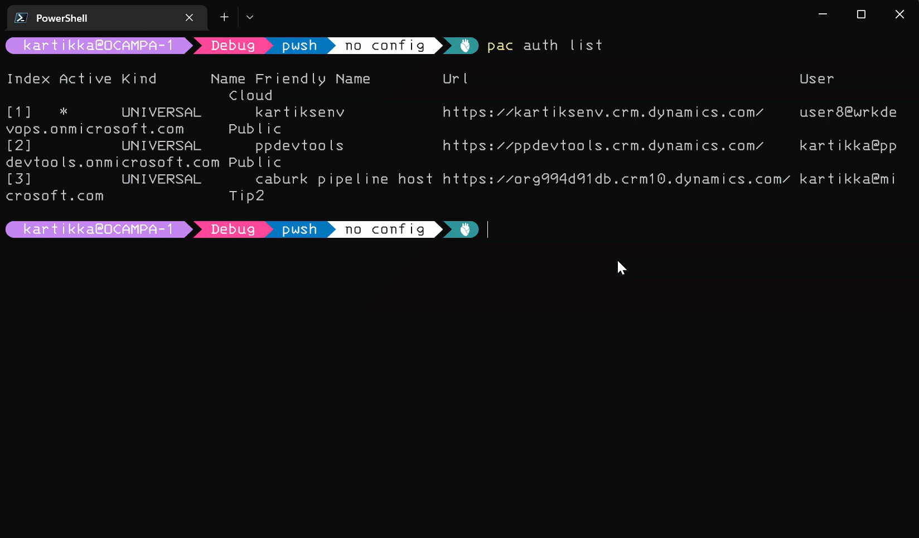

ALM & Power Platform CLI
Power Platform Build Tools and GitHub actions are built on Power Platform CLI

Slide 13
ALM & Power Platform CLI
ALM Accelerator
Extend in-product capabilities

Slide 14
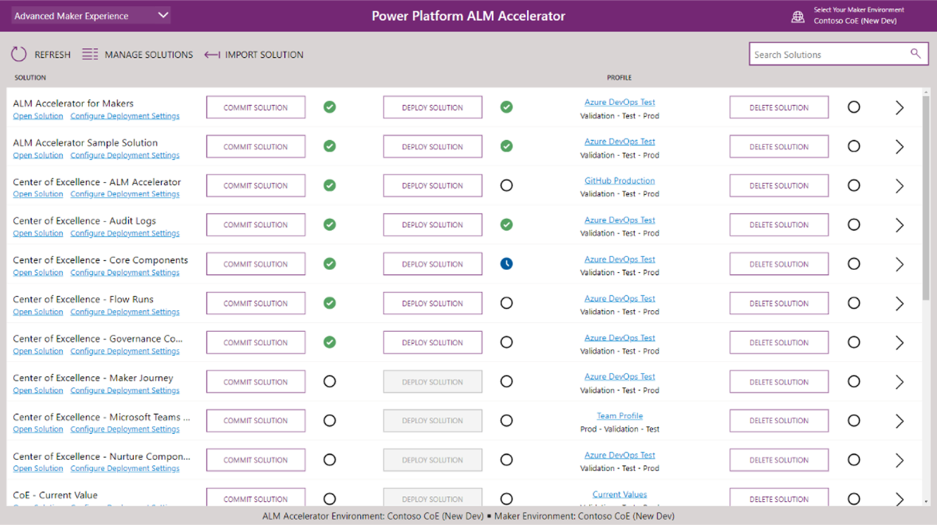
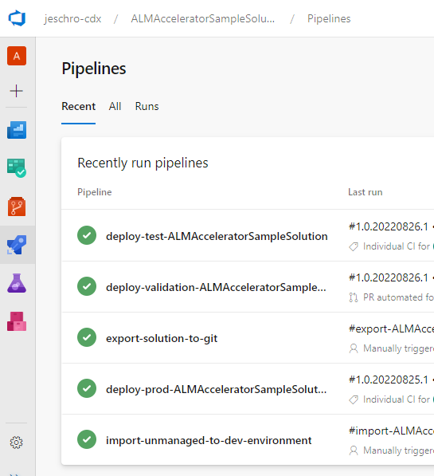
ALM Accelerator For Power Platform
Open-Source project maintained by Power CAT.
Built on top of Azure DevOps Build Tools, PAC CLI and Powershell
Aligned with latest in-product features and tools.
Customizable to suit the needs of an organization through configuration or extensions.
Github issues support.
Documentation on learn.microsoft.com.

Slide 15
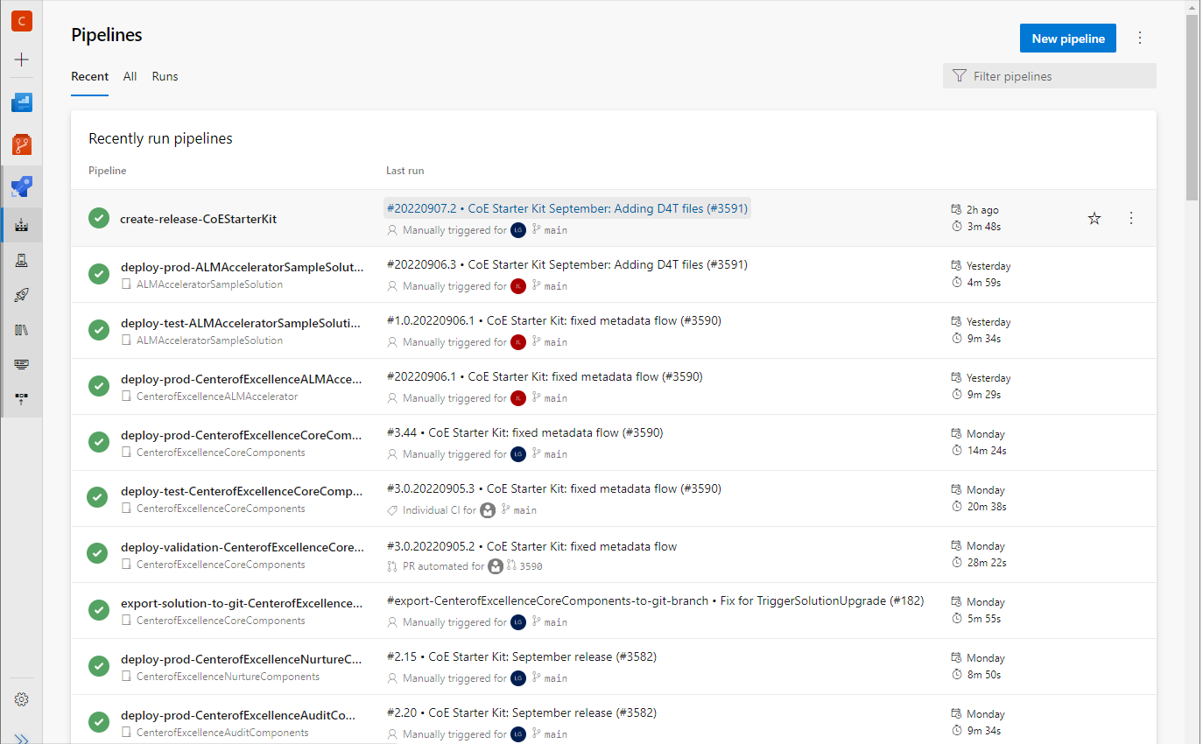
ALM Accelerator for Power Platform Components
Canvas and Model App
Allows Makers to configure deployments and interact with DevOps pipelines and repositories
Allows Admins to Configure User Experience and Access and setup Azure DevOps Projects
Predefined Pipelines
Export/Unpack Solution
Build/Import Solution
Delete Unmanaged Solution
Build/Deploy Solution
Modular YAML templates
Deployment settings for connections, component sharing and ownership, and permissions
Data Ingestion
Extension Points for customization

Slide 16
How should I think about all these options?
Capability | Pipelines | ALM Accelerator | DevOps/GitHub
IT / Developer involvement | Not required | Up front setup | Required for every project
Source Code integration | No, but planned | Yes | Yes
Code-first development | No, but planned | Yes | Yes
Managed Environments Required | Yes | No | No
Democratized for Citizen Development | Yes | Yes | No
In-Product Experience | Yes | No, Canvas App Interface | No
Sharing and Ownership Experiences | Yes | Yes | No
Maker requires elevated privileges in target environment | Service Principal Supported | Service Principal Supported | Service Principal Supported
aka.ms/almaccelerator

Slide 17


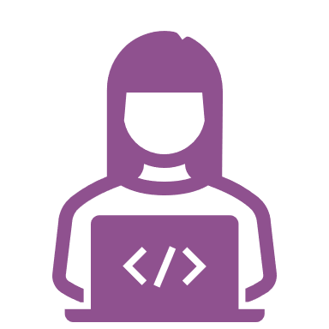
Powerful alone. Better together.
In-product ALM
Pipeline Extensions
Developer tooling

Slide 18
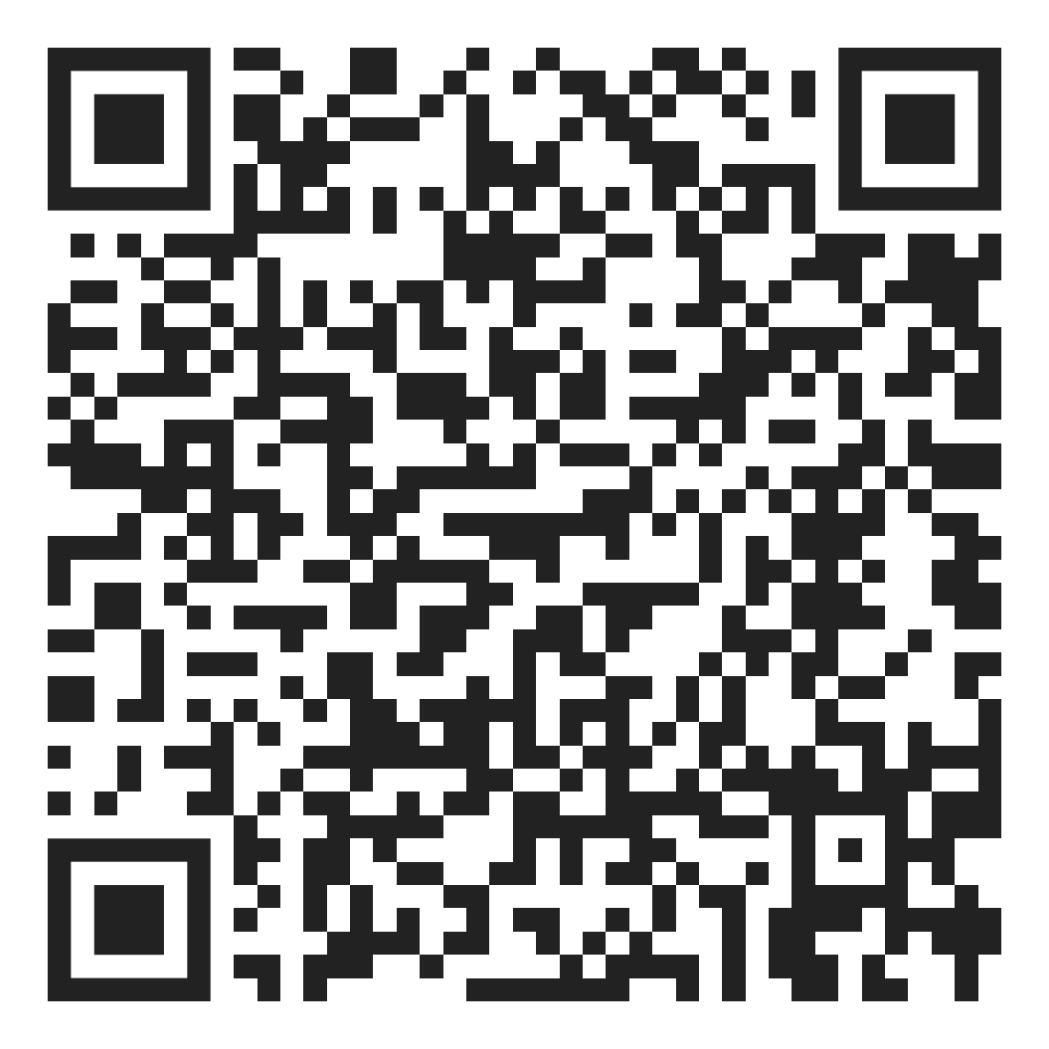
ALM & Power Platform CLI
Pipeline Extensions Demo
Follow along on Github

Slide 19



Summary and Questions?
Application Lifecycle Management of a software includes plan and track, develop, build and test, deploy, operate, monitor, and learn from discovery.
For a healthy ALM, there should be separate Dev, QA and Prod environments.
Source control should be your source of truth for storing and collaborating on your components.
Automated deployment mechanisms are preferred over manual.
Repeatable deployments with Pipelines for Power Platform
Automated deployment with Tools and Automation
Automated deployment with ALM Accelerator for Power Platform
Extend Pipelines with Pipeline Extensions

Slide 20

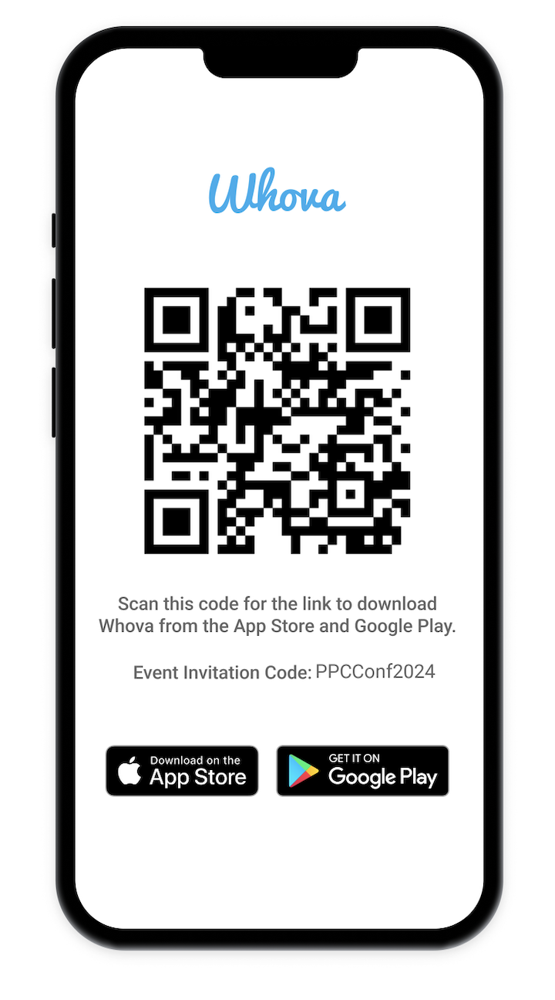
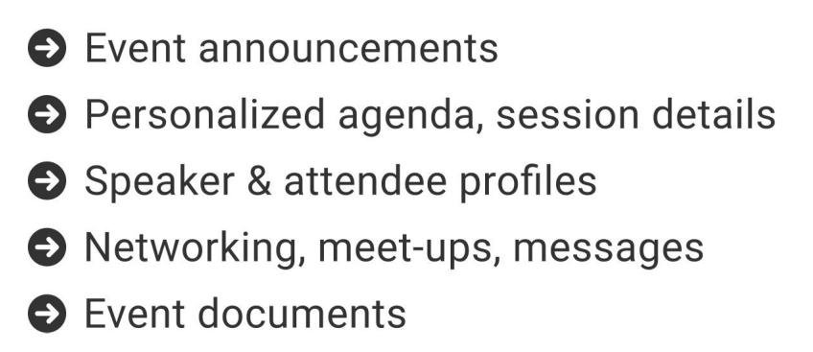
The official event app for the Power Platform Community Conference
Join the event app to access:
Event Invitation Code: PPCConf2024

Slide 21
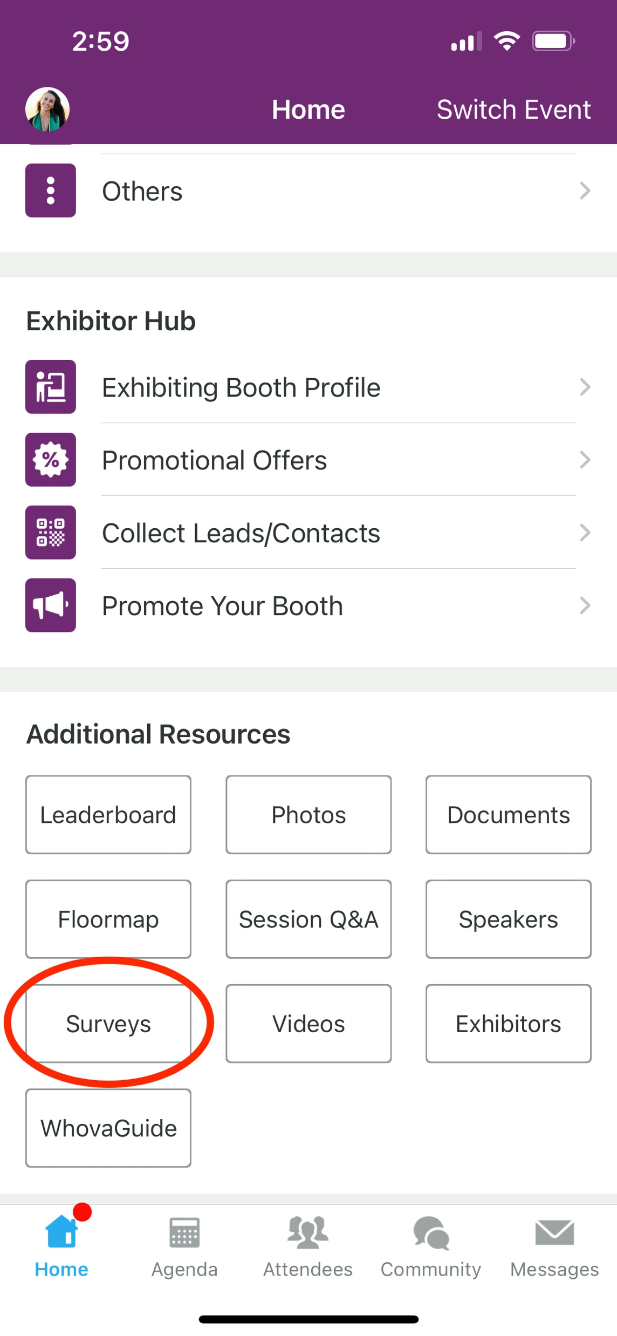
Session Feedback Surveys
We really want to hear from YOU!
In the pursuit of making next year’s Power Platform Community Conference even better, we want to hear your feedback about this session.
Here’s How -
Simply go to the Whova App on your smartphone
Scroll down on the Power Platform Community Conference Homepage to ‘Additional Resources’ to click “Surveys’.
Click Session Feedback.
Scroll down to find this session title.
Complete the session feedback survey.
Finally, click ‘Submit’
It’s just that easy!

